Slide 1
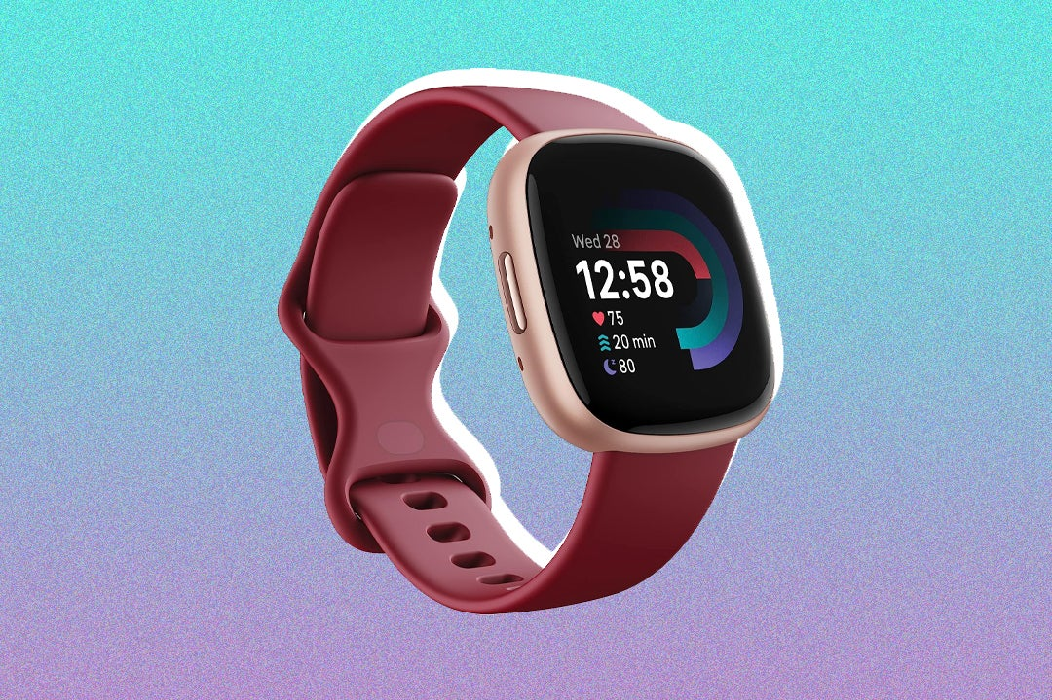
CapeSTONE Project
Analyzing FitBit Fitness Tracker App Data
Unveiling Consumer Insights for the Marketing Team
In this presentation, we delve into the world of FitBit app usage to uncover valuable insights and trends. Join us as we explore how consumers engage with the FitBit app, providing essential knowledge for the marketing team to refine strategies and enhance user experience. Let's embark on this data-driven journey together!
GADDAM LAKSHMI ANUSHA

Slide 2
AGENDA
Introduction
Primary goals
Areas of growth
Timeline
Summary

Slide 3
INTRODUCTION
HealthTrackers Inc.: Pioneering Wellness Through Technology
Who We Are: HealthTrackers Inc. is at the forefront of the health technology industry, dedicated to empowering individuals to lead healthier lives. Our innovative Fitbit devices are designed to provide users with detailed insights into their daily activities, sleep patterns, and overall wellness.
The Fitbit Industry: A Catalyst for Healthier Lifestyles
Why It Matters: In a world where health consciousness is rising, understanding consumer behavior is crucial. The Fitbit industry plays a pivotal role in this paradigm shift by offering tools that encourage active lifestyles and provide valuable health data.
Project Overview: Analytics Driving Strategy
Our Mission: This Capstone Project aims to delve deep into the data provided by Fitbit users to extract meaningful trends and insights. Our objective is to harness these findings to enhance our product offerings and refine our marketing strategies, ensuring that we meet our customers’ needs effectively.

Slide 4
process
Main
Directory
Processed & Merged CSV
Tableau Dashboard
Visualization
Raw data
Cleaned
Unprocessed CSV
EDA files
uncleaned
Data notebooks

Slide 5


Slide 6
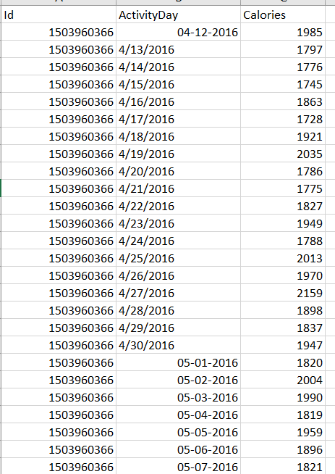
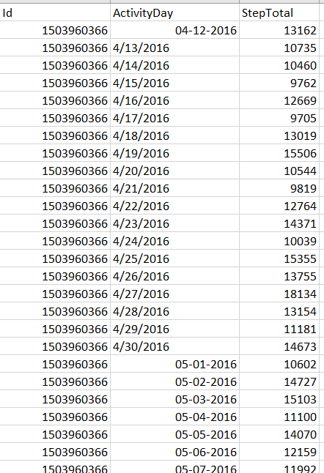
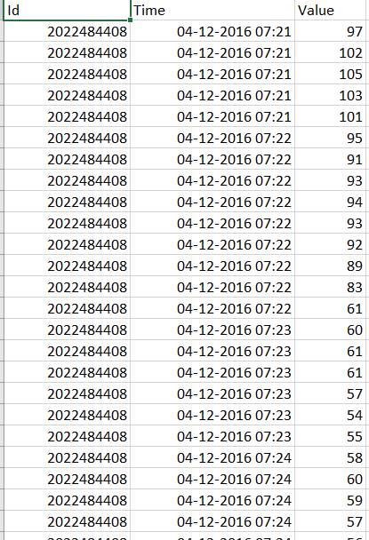
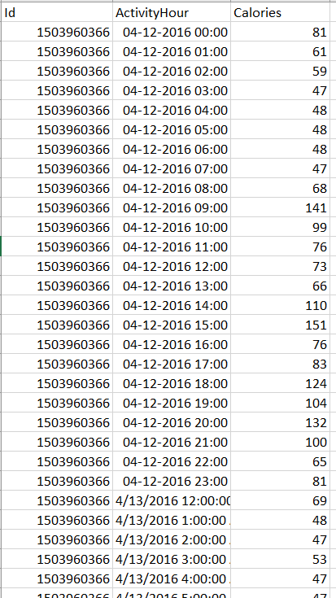
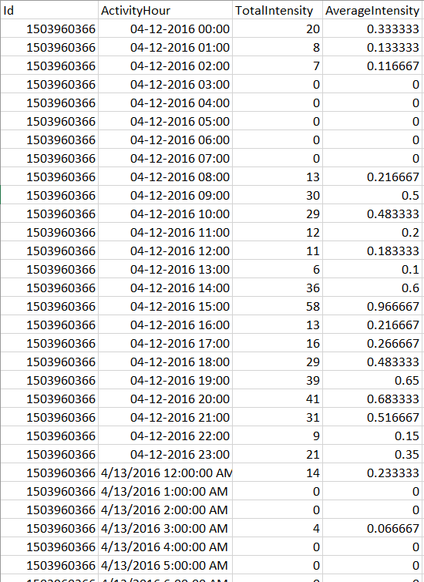
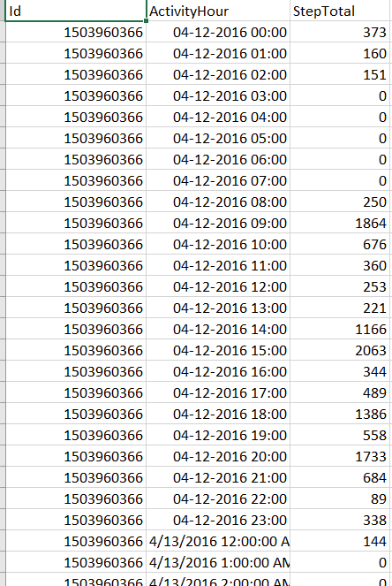
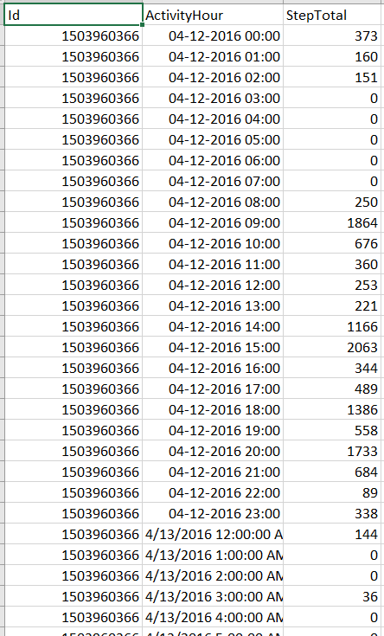
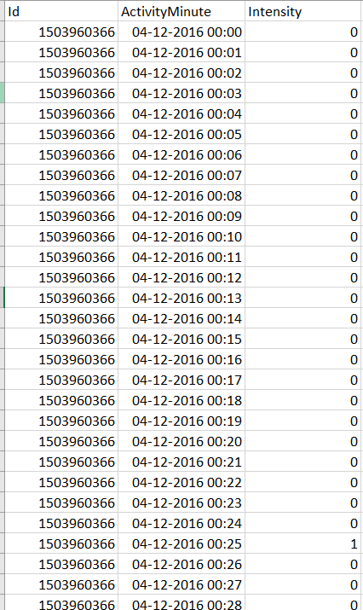
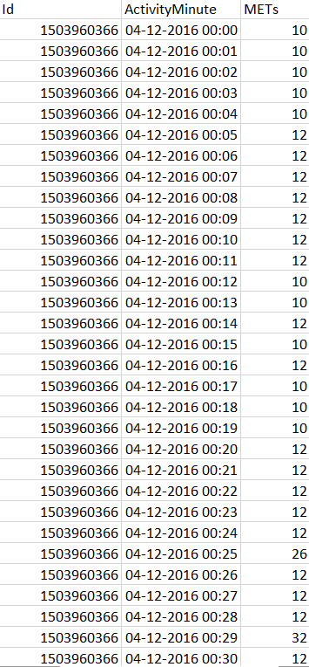
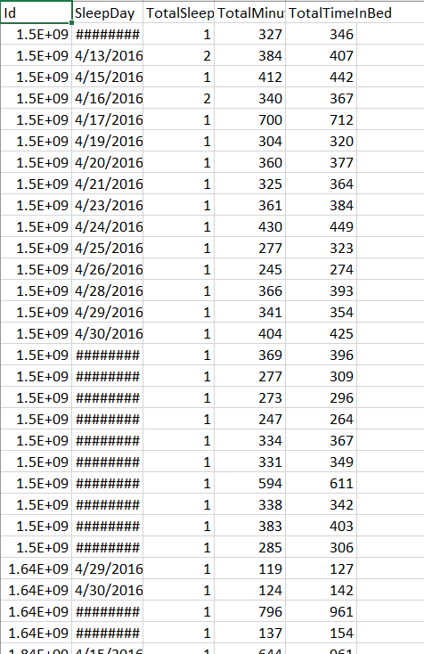
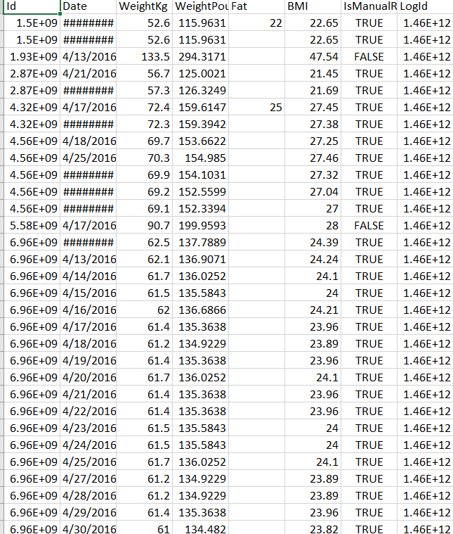
Unprocessed csv

Slide 7
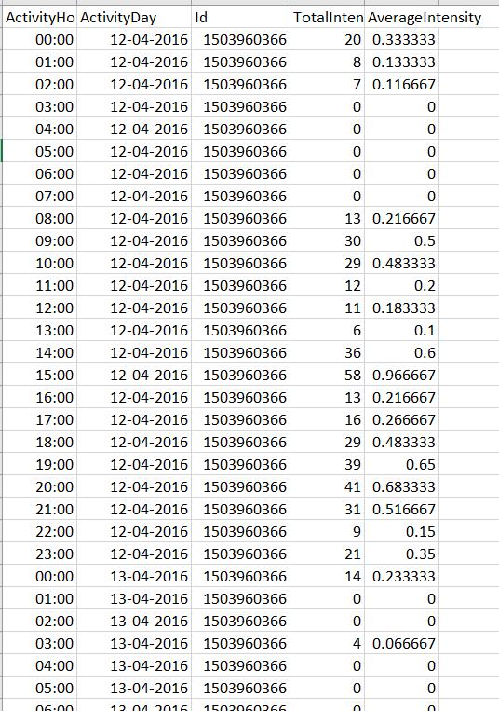
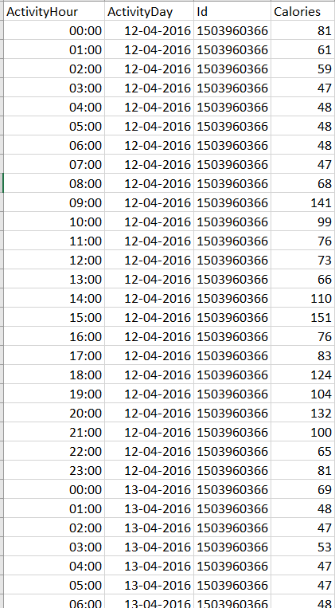
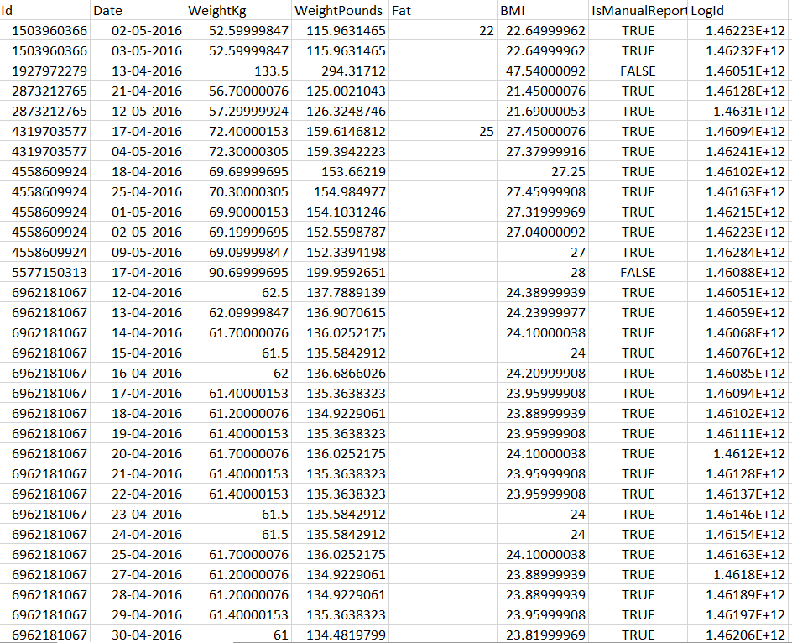
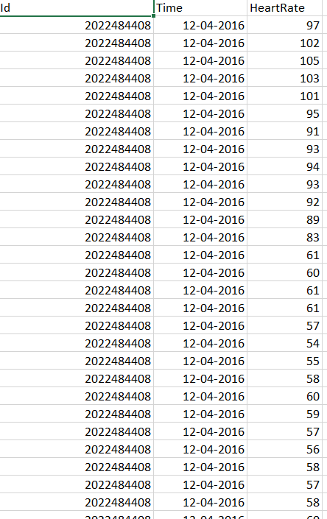
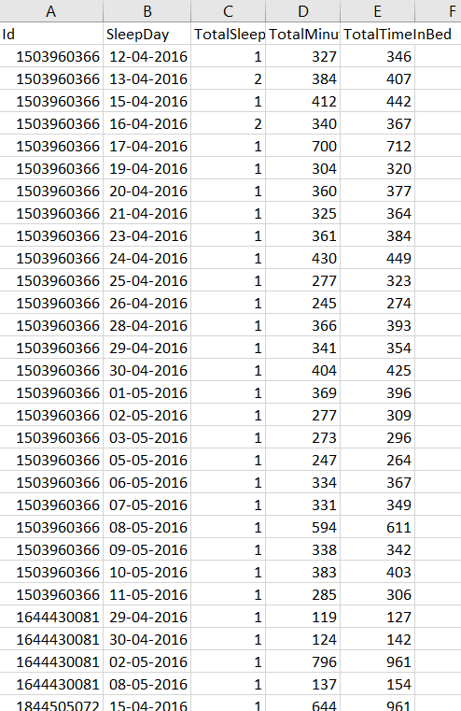
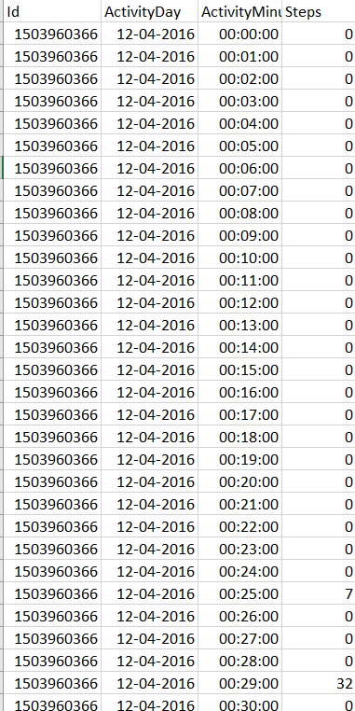
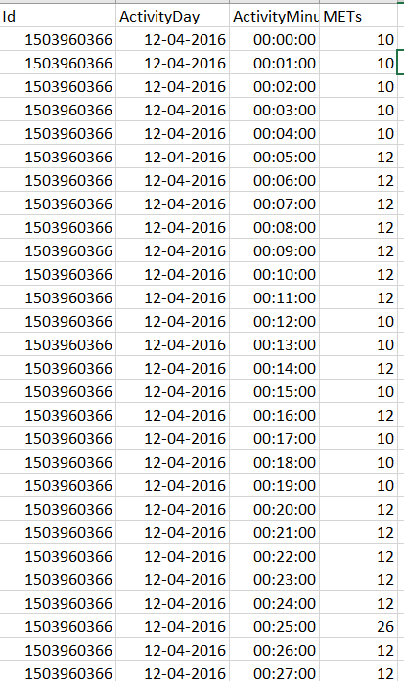
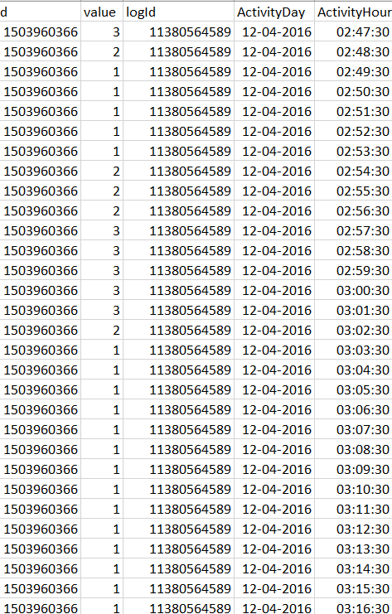
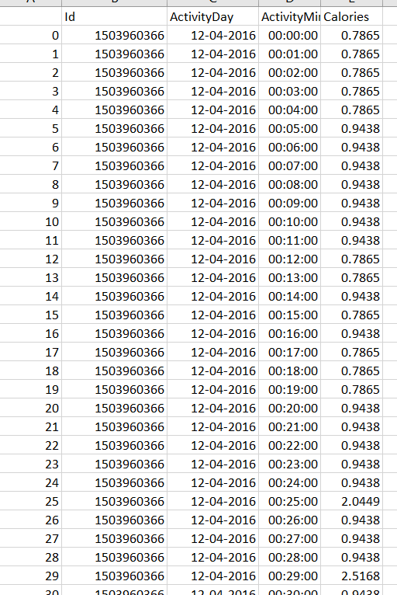
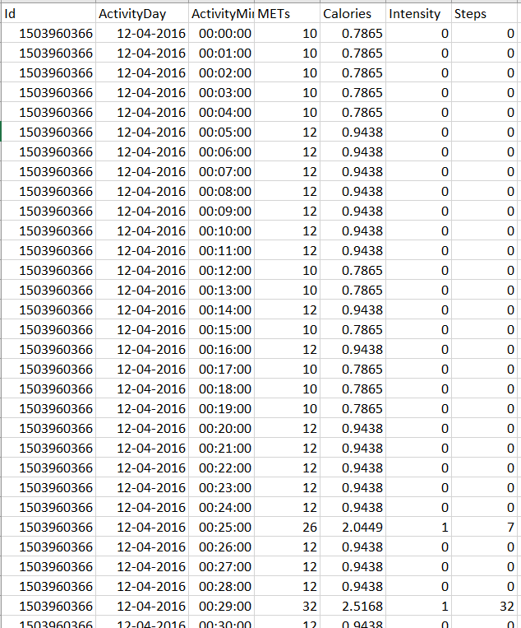
Processed csv

Slide 8
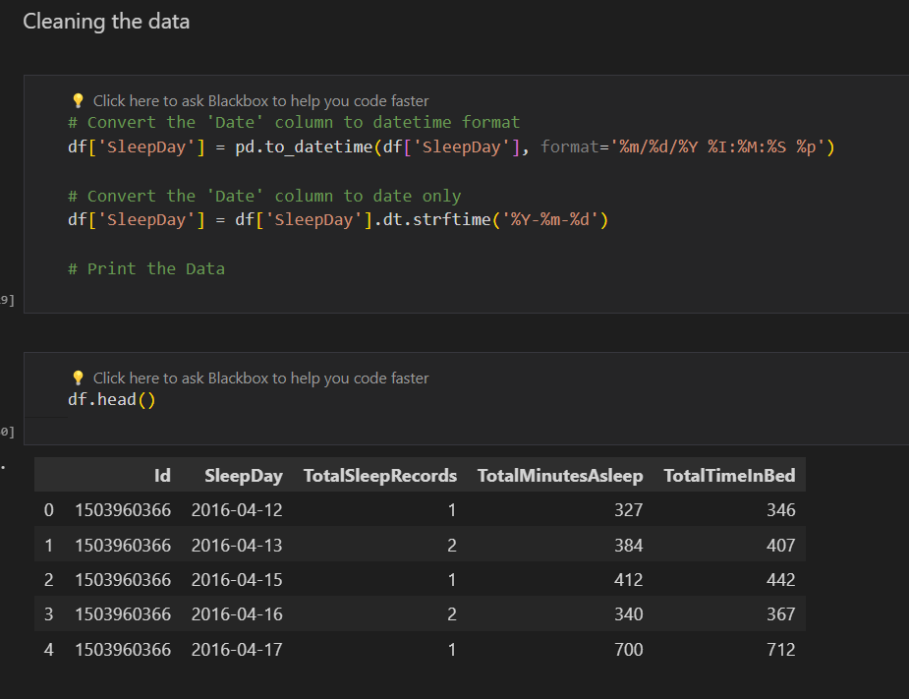
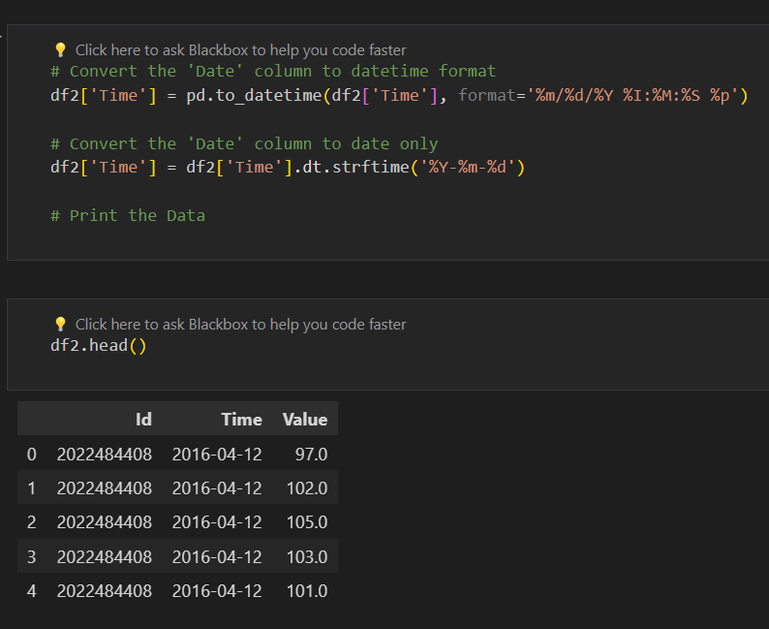
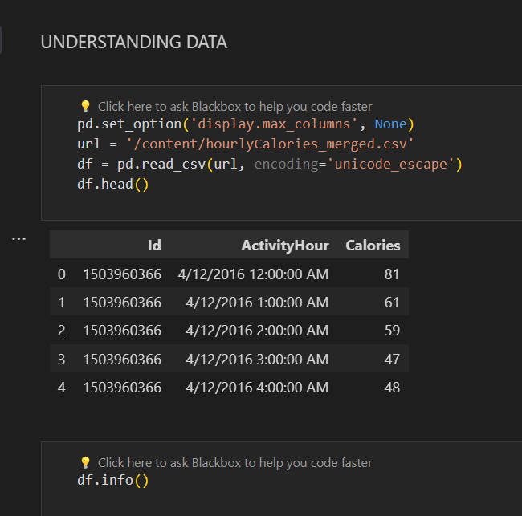
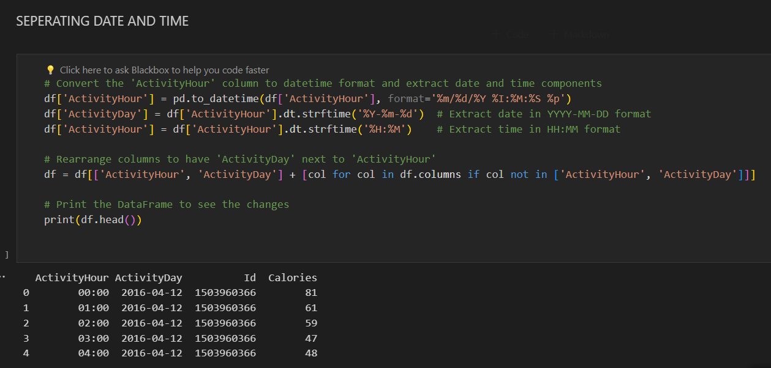

Slide 9
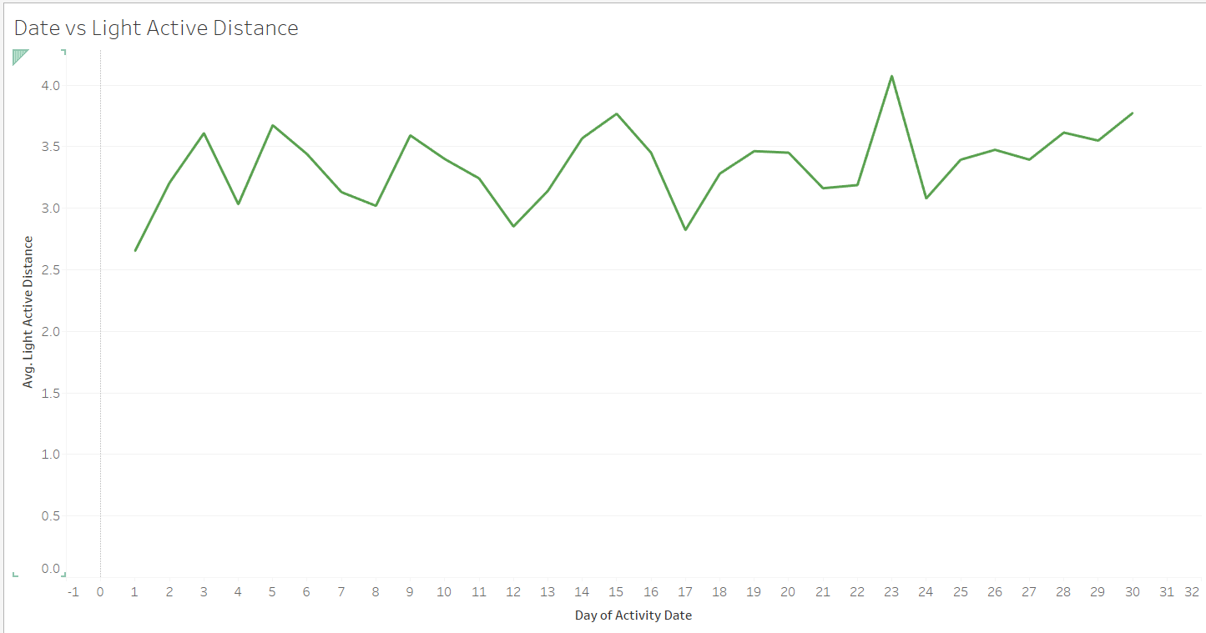
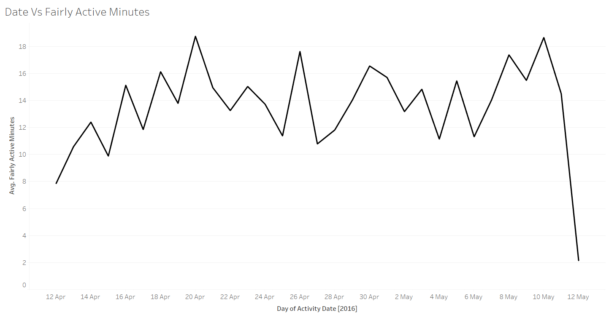
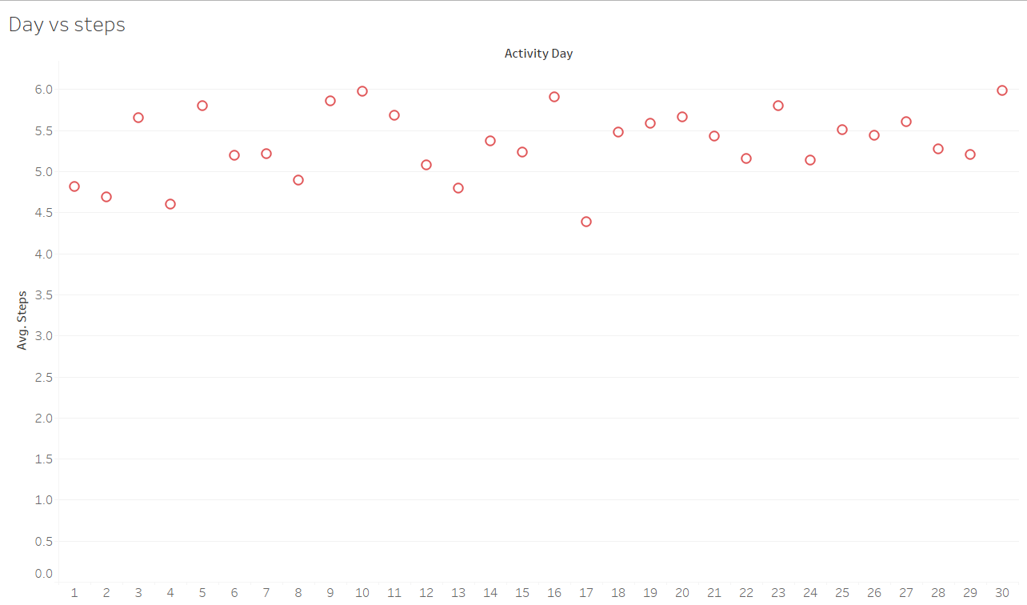
Tablaue Dashboard

Slide 10
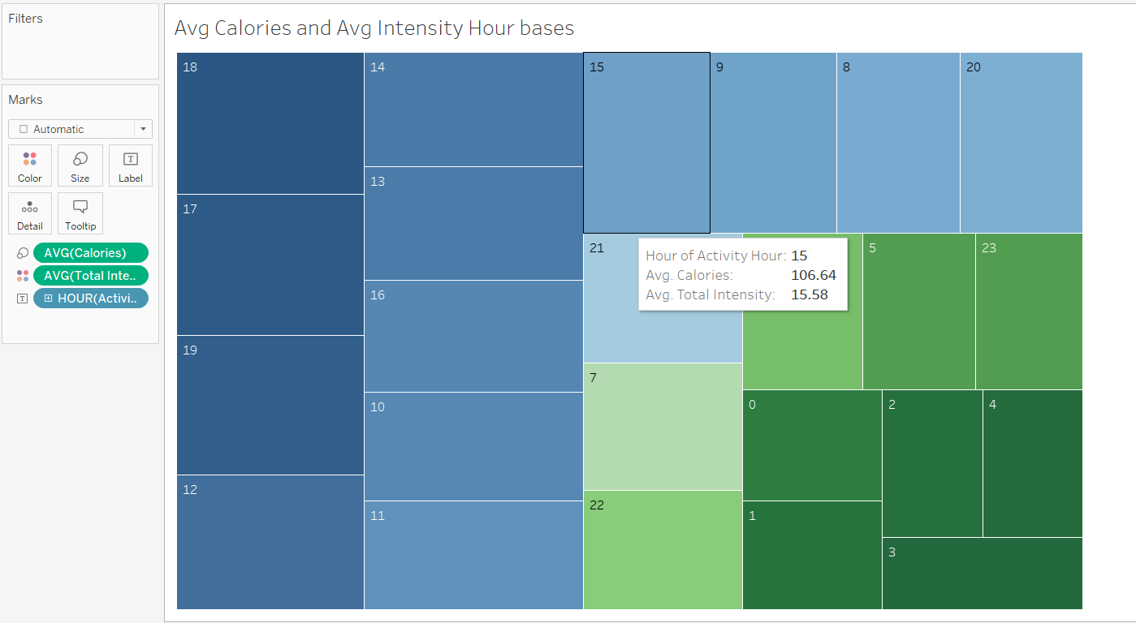
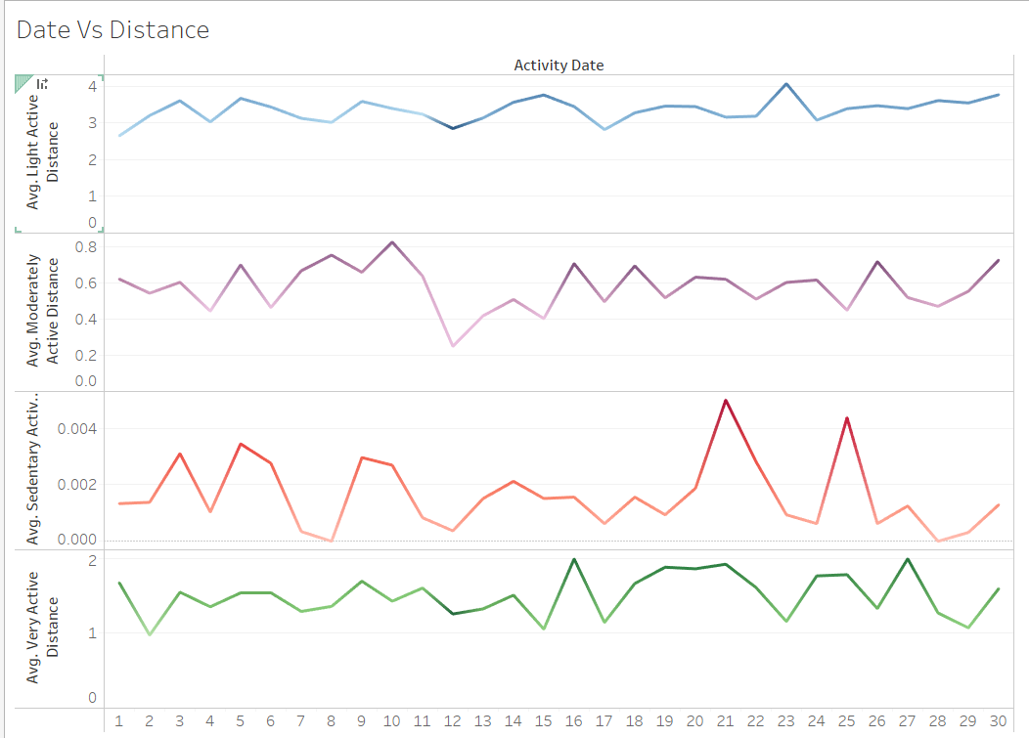

Slide 11
Key Insights →
❖ Peaks in calorie burning at certain times of the day were observed, indicating potential periods of high activity.
❖ Differences in total steps taken between weekdays were revealed, suggesting varying activity levels throughout the week.
❖ No clear correlation between calories burned and total intensity was found, indicating other factors may influence calorie burning.
❖ Variability in average intensity levels between weekdays was highlighted, suggesting potential patterns in activity levels.
❖ Distribution of steps taken over time was illustrated, indicating peak activity times and potential trends in activity levels throughout the week.
Conclusion →
❖ The analysis provides a detailed understanding of activity and calorie burning behavior based on the merged dataset.
❖ Insights can help in optimizing activity levels and understanding patterns for better health and fitness

Slide 12
THANK YOU
GADDAM LAKSHMI ANUSHA gcrgla0089@gmail.com

